Slide 1
CHEAT SHEET FOR HTML

Slide 2
Members:
AANSHULA SHETTY
NIDHI WORAH
HARSHVARDHAN THAKUR

Slide 3
Introduction:
Just like the name suggests, a very small compact sheet containing all the formulas, important points, theories to take into exam. idea is to condense as much info as possible in small space. for programming languages its generally a compilation of important syntax, neat tricks, data types, commonly used library functions.

Slide 4
Our project:
We tried to create a webpage using html and css.
It contains the cheat sheet of HTML for beginners to learn attributes, tags, creating lists and tables.
It can help them to grasp the basics of html and how can they create their own website with ease

Slide 5
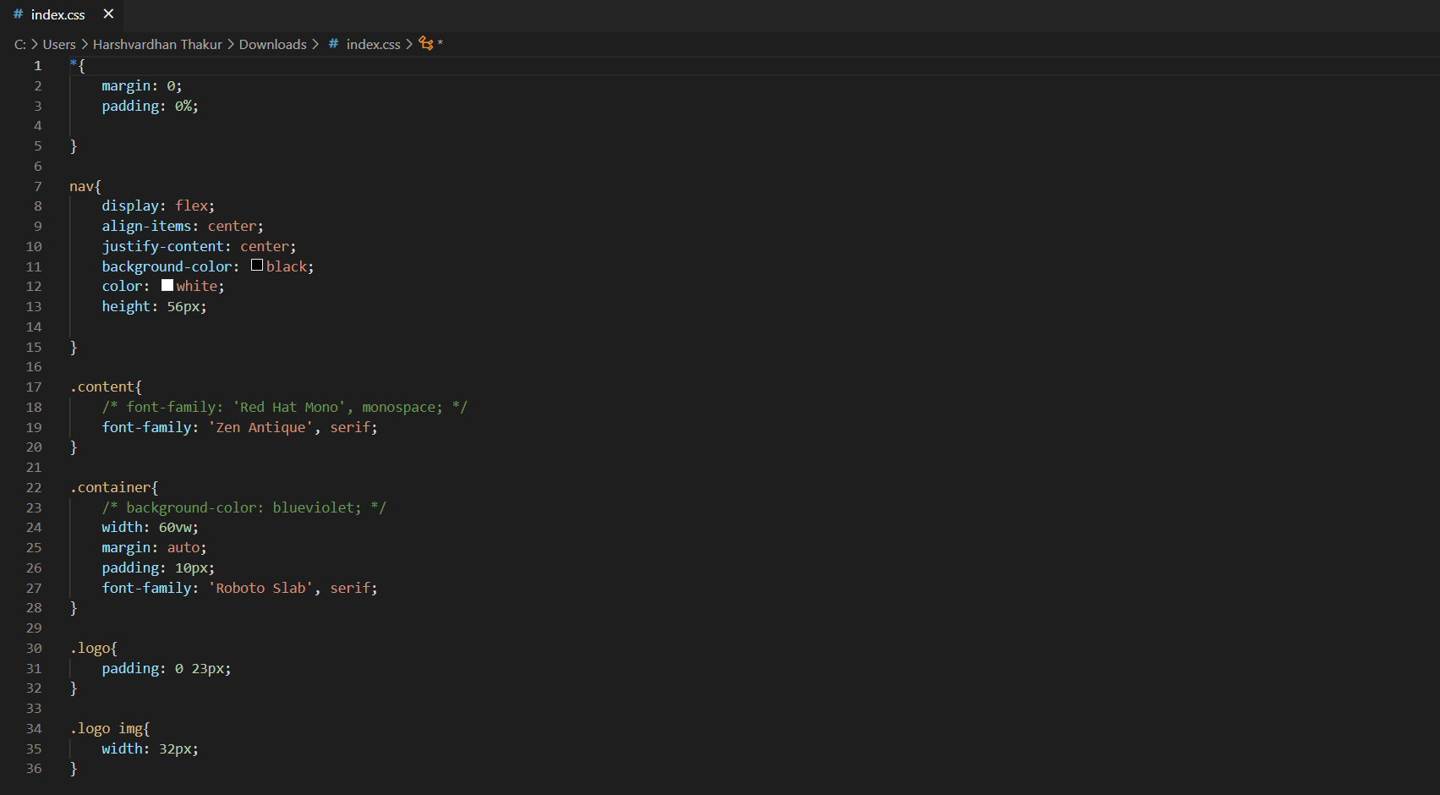
Our code:

Slide 6
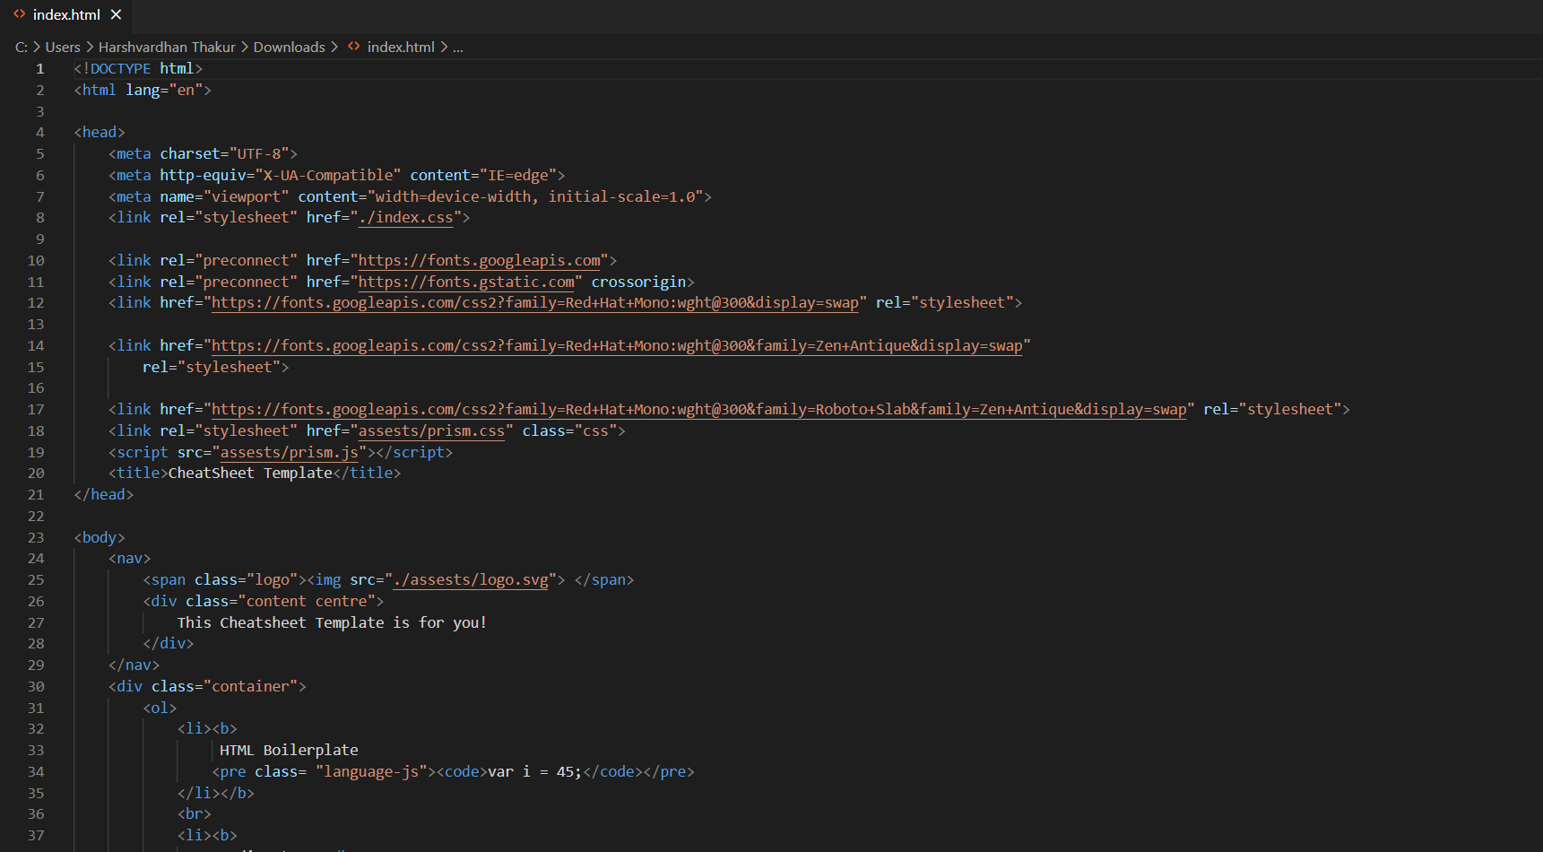
Our code:

Slide 7
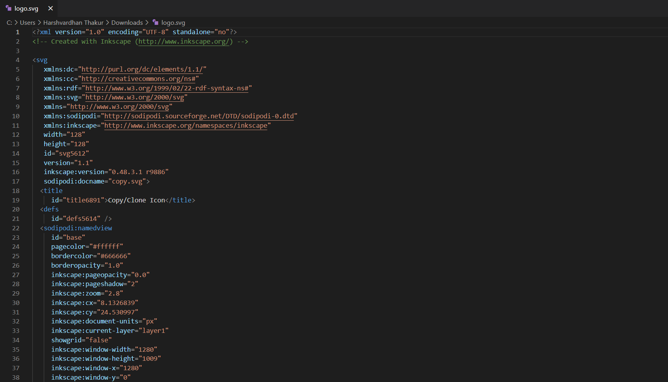
Our code:

Slide 8
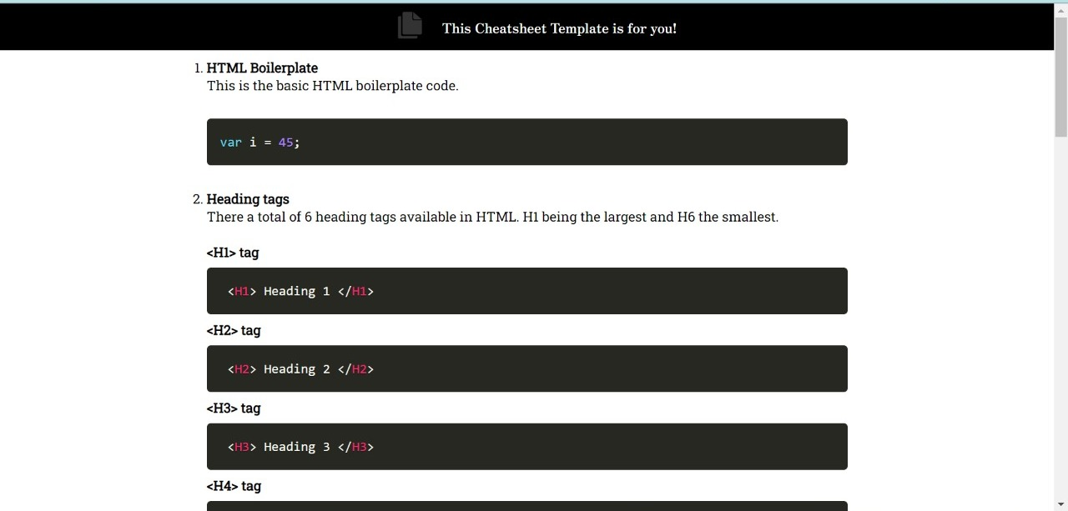
Output:

Slide 9
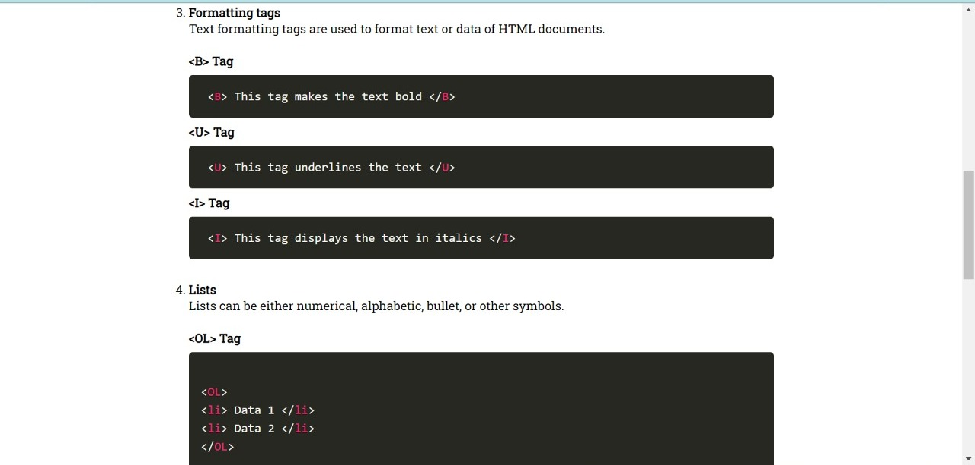
Output:

Slide 10
Conclusion:
During this presentation we learned many different things many different attributes, tags, etc which we will use in future and will apply that on our webpages

Slide 11
Thankyou

